Slide 1
Human Activity Recognition (HAR) Transfer Learning
Mica Haney
Kushal Patel
Vrushabh Ajaybhai Desai
Mayur Vora
Rhea Chitturu
Sreeja Bellamkonda

Slide 2
Team Members
Name | Email | Role
Mica Haney | micahaney@my.unt.edu | Team Leader
Kushal Patel | kushalpatel2@my.unt.edu | Team Member
Vrushabh Ajaybhai Desai | VrushabhAjaybhaiDesai@my.unt.edu | Team Member
Mayur Vora | Mayuriswarbhaivora@my.unt.edu | Team Member
Rhea Chitturu | rheachitturu@my.unt.edu | Team Member
Sreeja Bellamkonda | Sreeja.Bellamkonda@my.unt.edu | Team Member

Slide 3
Abstract
In the previous iteration of this project, using transfer learning in the domain of human activity recognition (HAR) was performed. The project specifically looked at adding in new activities, using data from the same dataset. This allows for the model to look only at the activities without having to decide if the activity comes from one collection method or another.
This iteration of the project proposes to tackle that problem, and see if transfer learning is a valid approach to working with multiple datasets. If so, this would indicate a way for handling real-world problems where data collection methods might differ between locations and patients due to obstacles such as sensor availability, safety restrictions, collection protocol, etc.

Slide 4
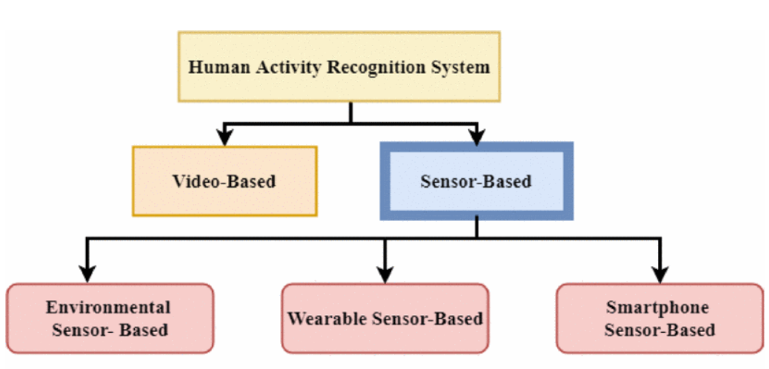
Introduction: HAR
Human Activity Recognition (HAR) is predicting the movement of a person such as walking, talking, standing, and sitting.
Data could be based on sensor data, such as an accelerometer in a smartphone or wearables or video.

Slide 5
Common Challenges of HAR
Below are aspects of HAR data that often cause significant issue when training models.
Diversity of age, gender, and number of subjects.
Postural transitions (Sitting to Standing, Walking to Jogging etc).
Number of sensors and types of sensors.
Missing values or labeling errors.
Complex activities.
Sparse data.

Slide 6
Introduction: Transfer Learning
Transfer learning is a form of fine-tuning.
Only certain layers are updated, the rest are frozen and the weights don’t update.
This allows for the model to adjust to the new dataset by leveraging the pre-trained model’s knowledge of the original dataset without losing any information contained in the pre-trained weights.
The dataset pre-training is done on is the source dataset.
The dataset fine-tuning is done on is the target dataset.
The target dataset must closely resemble the source dataset.

Slide 7
Design
Data
All code is written in Google Colab, with the data stored in Google Drive.
The code is written in python, and largely uses the tensorflow, sklearn, pandas, numpy, and pyplot libraries.
Data will be analyzed then preprocessed only once, initially. This will be repeated if experimentation requires it and time allows.
Experiments will be run in sets of 5, with a naive, two initial/source, and two transfer models.
Source Dataset
Target Dataset
Preprocess Data
Preprocess Data
Preprocessed Source Dataset
Preprocessed Target Dataset
Experiments
Naive Model
Initial Model Target Validation
Transfer Model Target Validation
Results

Slide 8
Datasets
Name | Users | Shape | Activites
Wearable HAR | 22 | (11,600, 121) | 7 (jump, lie down, sit, stand, stairs down, stairs up, and walk)
UCI HAR | 30 | (20,598, 562) | 6 (lie down, sit, stand, stairs down, stairs up, and walk)
UCI HAPT | 30 | (20,432, 562) | 6 (lie down, sit, stand, stairs down, stairs up, and walk) + 2 (stand-to-sit, sit-to-stand)
UniMiB | 30 | (12,428, 454) | 9 (jump, lie down, sit, stand, stairs down, stairs up, and walk, Jogging)
WISDM | 36 | (4,774, 406) | 6 (Walking, Jogging, Upstairs, Downstairs, Sitting)

Slide 9
Data
We chose the UCI HAR dataset to be our source dataset, and the WISDM dataset to be the target. These selections were made purely based on sample counts.
UCI HAR:
34,444 sampes
3,088 samples
2,912 samples
3,554 samples
3,812 samples
3,888 samples
Total: 20,598 samples
WISDM:
456 sampes
1,557 samples
571 samples
1,728 samples
264 samples
198 samples
Total: 4,774 samples

Slide 10
Model
2 model architectures were initially constructed, a dense network and a CNN. However, due to time constraints only the dense network was used.
Dense Architecture:
Input layer
7 fully connected layers, starting at 1024 hidden units and halving the count each successive layer
Output layer, softmax activation

Slide 11
Experimental Setup
Each architecture was trained three times per experiment.
One “naive” baseline of end-to-end training.
One source model for transfer learning.
One target model via transfer learning.
Each experiment was run five times and the average scores were reported.

Slide 12
Experimental Setup (Cont.)
Thirty-nine experiments were run:
Baseline
Drop Learning Rate by 1
Drop Learning Rate by 2
Raise Learning Rate by 1
2 Unfrozen Layers
3 Unfrozen Layers
4 Unfrozen Layers
5 Unfrozen Layers
6 Unfrozen Layers
7 Unfrozen Layers
8 Unfrozen Layers
5 Samples of Each Target Class Kept
10 Samples of Each Target Class Kept
15 Samples of Each Target Class Kept
20 Samples of Each Target Class Kept
25 Samples of Each Target Class Kept
30 Samples of Each Target Class Kept
35 Samples of Each Target Class Kept
40 Samples of Each Target Class Kept
45 Samples of Each Target Class Kept
50 Samples of Each Target Class Kept
55 Samples of Each Target Class Kept
60 Samples of Each Target Class Kept
65 Samples of Each Target Class Kept
70 Samples of Each Target Class Kept
75 Samples of Each Target Class Kept
80 Samples of Each Target Class Kept
85 Samples of Each Target Class Kept
90 Samples of Each Target Class Kept
95 Samples of Each Target Class Kept
100 Samples of Each Target Class Kept
105 Samples of Each Target Class Kept
110 Samples of Each Target Class Kept
115 Samples of Each Target Class Kept
120 Samples of Each Target Class Kept
125 Samples of Each Target Class Kept
130 Samples of Each Target Class Kept
135 Samples of Each Target Class Kept
140 Samples of Each Target Class Kept

Slide 13
Training
Hyperparameters:
40 epochs per naive model, 20 epochs per initial and per transfer model.
5 runs per model training.
Learning rates of 1e⁻³ or 1e⁻⁵. Settled on 1e⁻³ after hyperparameter tuning.
Freeze all but 1 to 8 layers for transfer learning. Settled on 6 unfrozen layers after hyperparameter tuning.

Slide 14
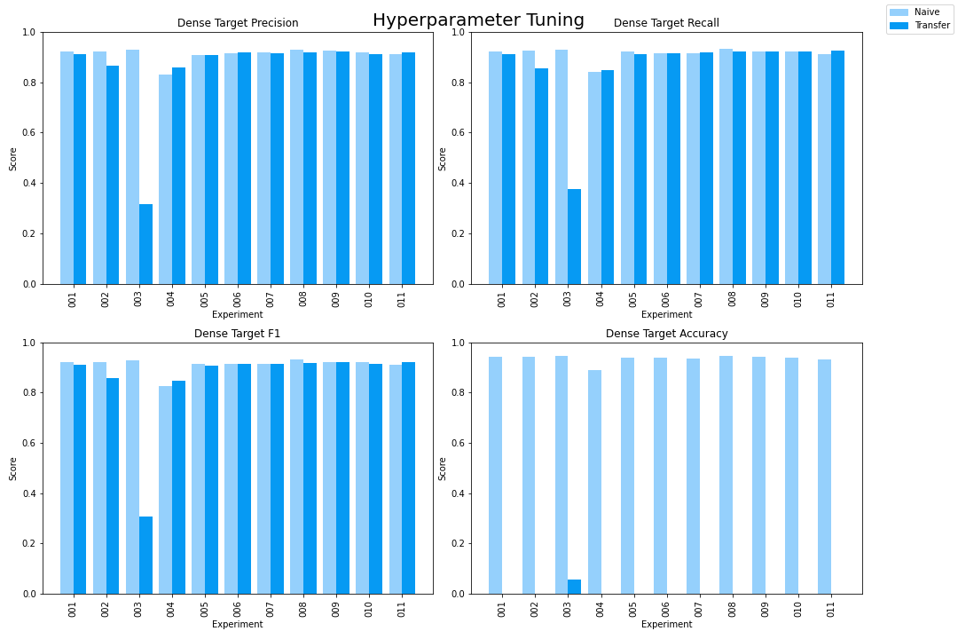
Results: Hyperparameter Tuning
The first 11 experiments were done to tune the hyperparameters. Learning rate had a significant impact on transfer learning scores, however the differences between the scores of the number of layers left unfrozen is negligible.

Slide 15
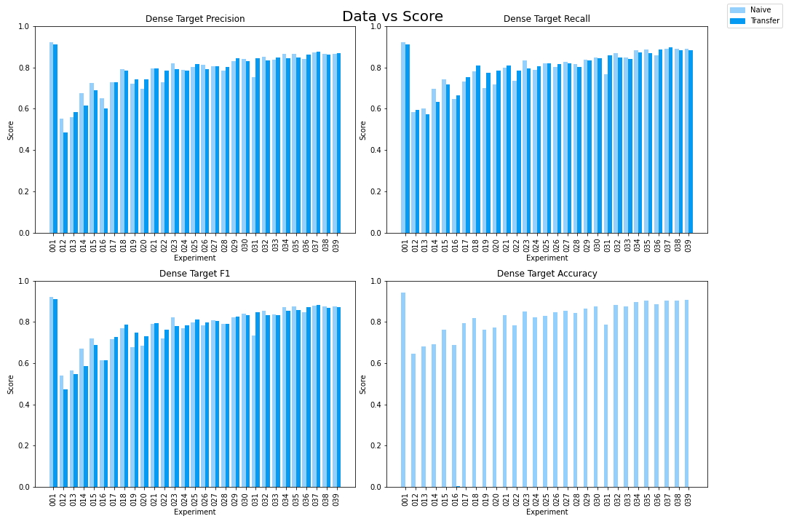
Results: Data in Target
The experiments after 11 looked at keeping n samples of each activity in the target training set. The validation and test sets were not restricted.
Overall the trend is that more data improves scores quickly for low values, but starts to converge at values of n at roughly 60.
Notably the transfer learning scores largely match the naive scores in all metrics besides accuracy. We are uncertain what is causing these results at this time.

Slide 16
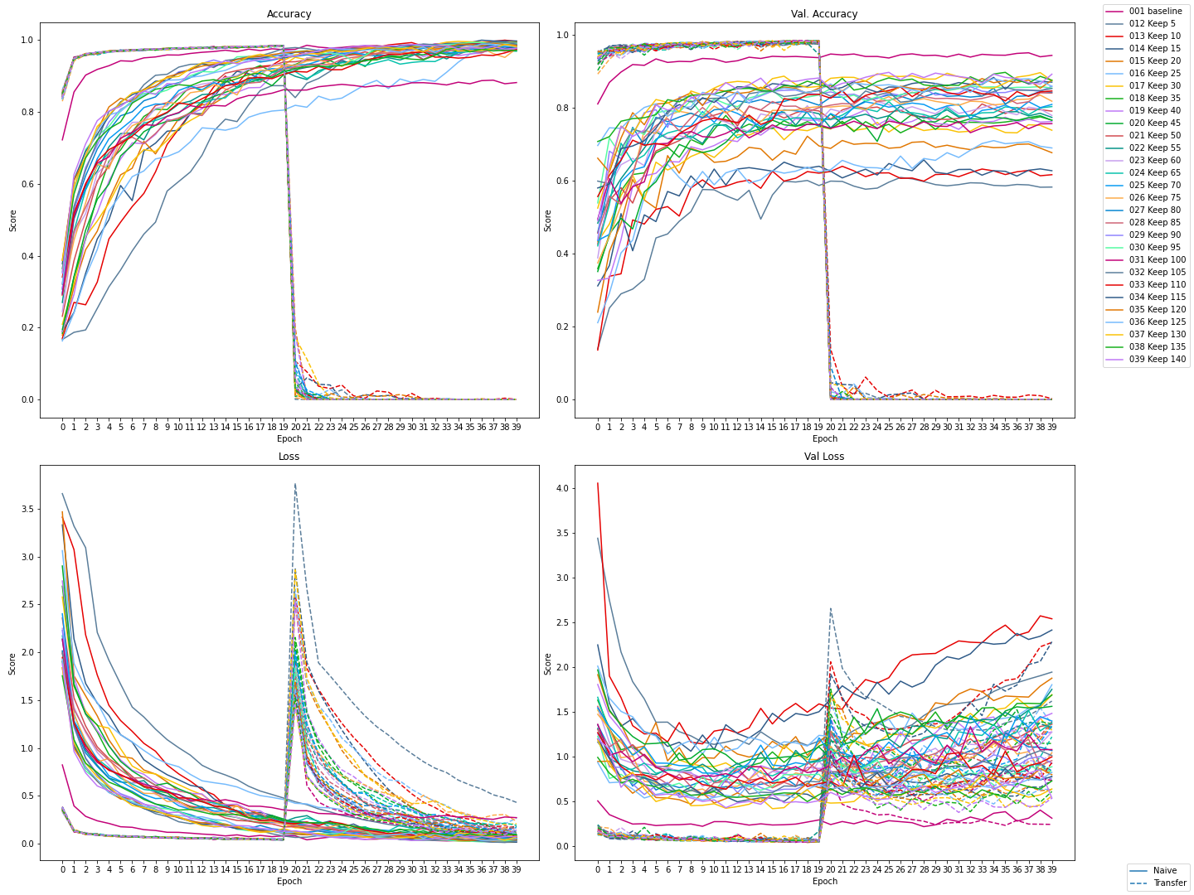
Results: Training Curve
After plotting all learning curves of both the naive and transfer models it became apparent that transfer learning scores became terrible once the transfer learning training started, with both training and validation accuracy almost instantly going to 0 and validation loss rising.

Slide 17
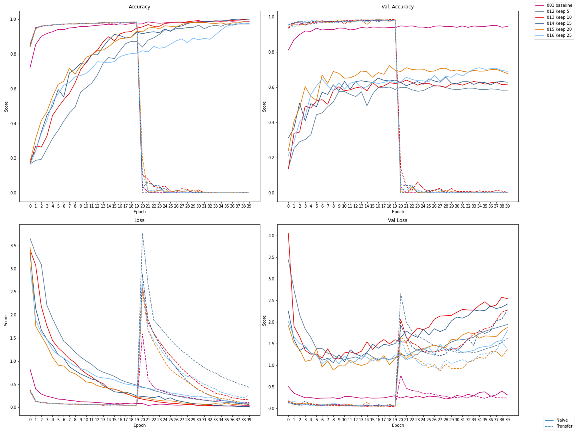
Experiments 1, 12 - 16

Slide 18
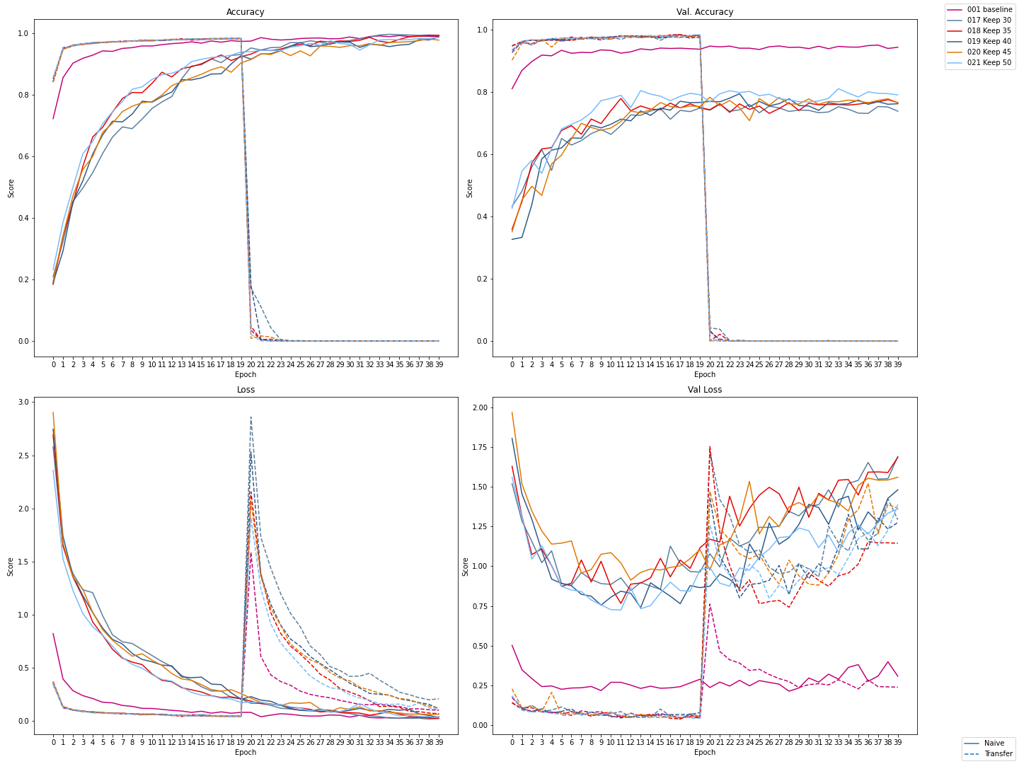
Experiments 1, 17 - 21

Slide 19
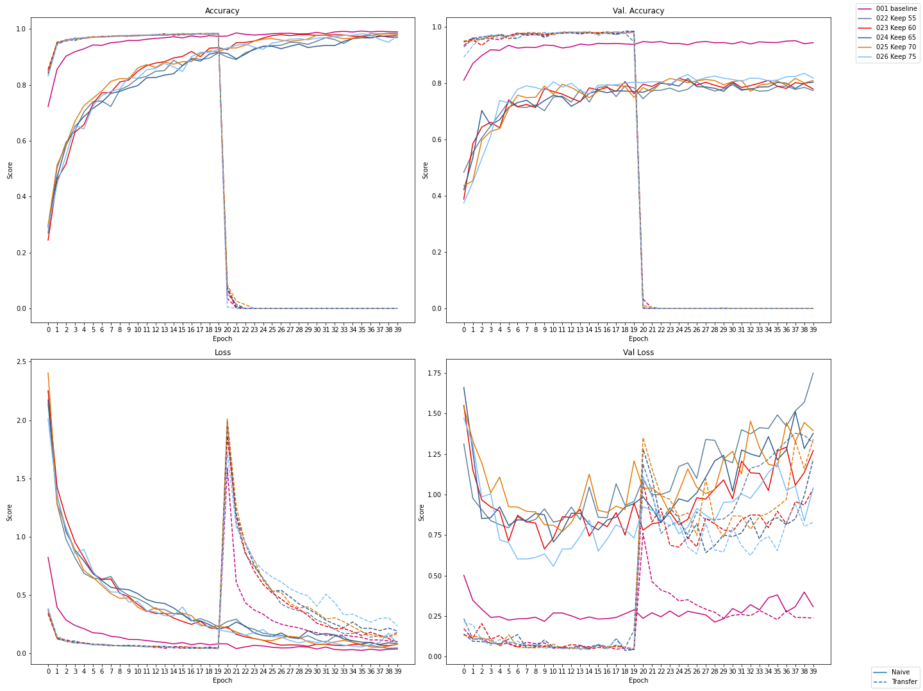
Experiments 1, 22 - 26

Slide 20
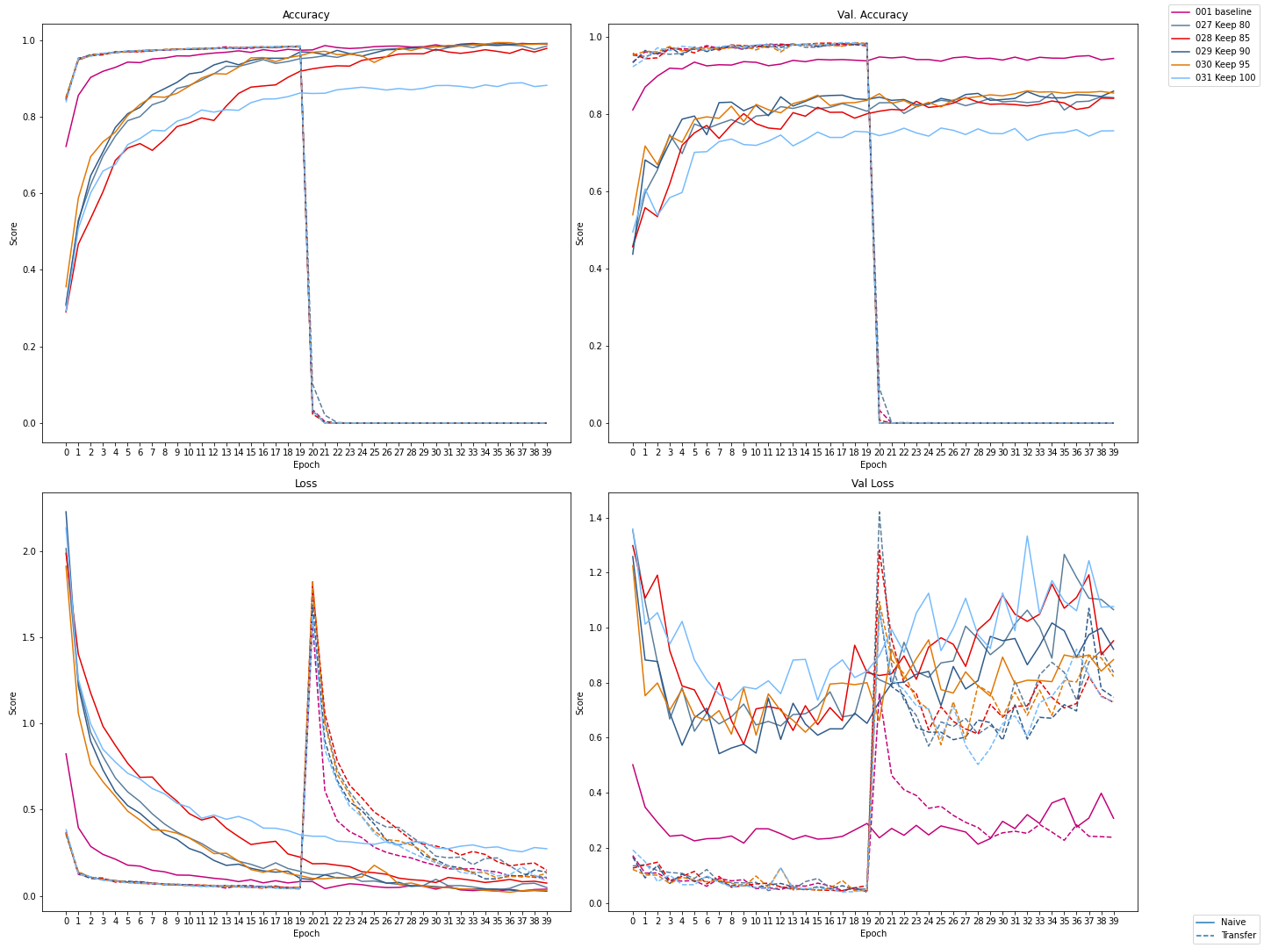
Experiments 1, 27 - 31

Slide 21
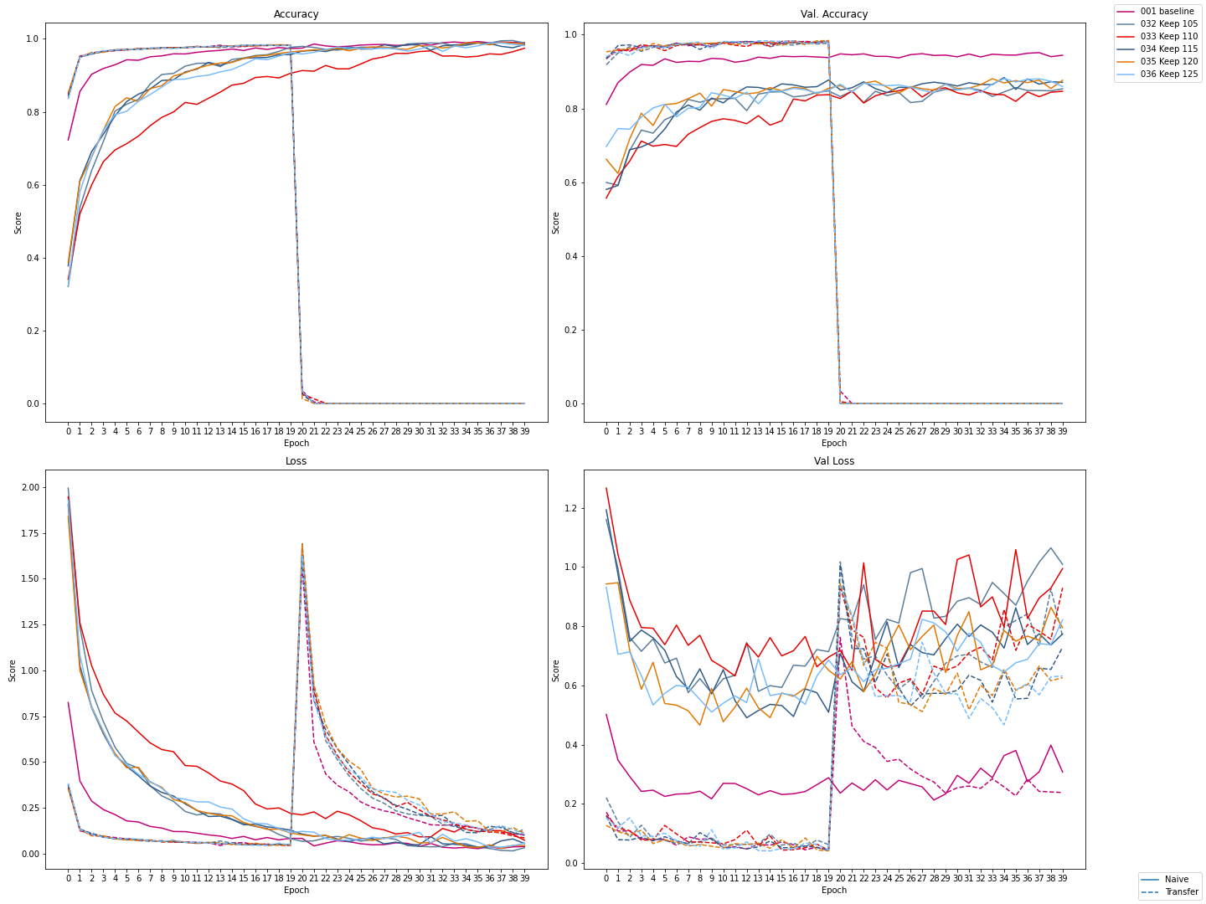
Experiments 1, 32 - 36

Slide 22
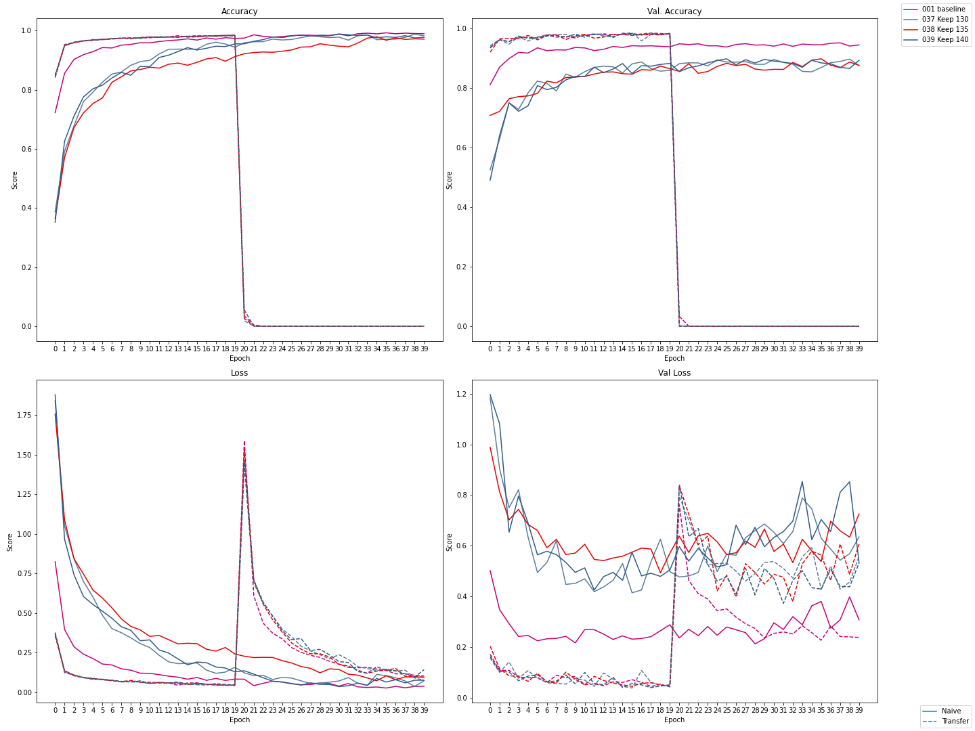
Experiments 1, 37 - 39

Slide 23
Results: Evaluation
Overall due to the terrible learning curves once transfer learning is enacted, we can say that transfer learning performed poorly in this case. However, the end-of-learning precision, recall, and F1 scores indicate that the transfer learning is indeed working. Further analysis is needed to find the reason for the score discrepancy.
As things stand, transfer learning is possible between datasets. However, the reliability of such learning is dubious.

Slide 24
Archive
Google Drive: https://drive.google.com/drive/folders/1yNPxni1lCeFX3IWXAt7JjG1VGg554cfD?usp=sharing

Slide 25
Related Projects
HAR Using Deep NN Notebook:
https://www.kaggle.com/code/euneun000/har-using-deep-nn
Kaggle notebook of a deep NN applied to the UCI HAR dataset.
Previous Transfer Learning with Gesture Recognition Project Proposal:
https://docs.google.com/document/d/1KqirKmIku6rEnOwq15qis8jAqeeJV2uS32YsoERjczw/edit
Project proposal from the Fall 2021 semester of CSCE 5380.

Slide 26
References
An, S., Bhat, G., Gumussoy, S., & Ogras, U. (2020). Transfer Learning for Human Activity Recognition using Representational Analysis of Neural Networks. arXiv preprint arXiv:2012.04479.
Levin, R., Cherepanova, V., Schwarzschild, A., Bansal, A., Bruss, C. B., Goldstein, T., ... & Goldblum, M. (2022). Transfer Learning with Deep Tabular Models. arXiv preprint arXiv:2206.15306.
Pang, J. (2018). Human Activity Recognition Based on Transfer Learning.
Patel, S. (2022, April 15). Deep Transfer Learning for Human Activity Recognition. Medium. Retrieved September 14, 2022, from https://medium.com/@sarjakpatel1999/deep-transfer-learning-for-human-activity-recognition-d291a7731154
Yan, Y., Liao, T., Zhao, J., Wang, J., Ma, L., Lv, W., ... & Wang, L. (2022). Deep transfer learning with graph neural network for sensor-based human activity recognition. arXiv preprint arXiv:2203.07910.

